Slide 1


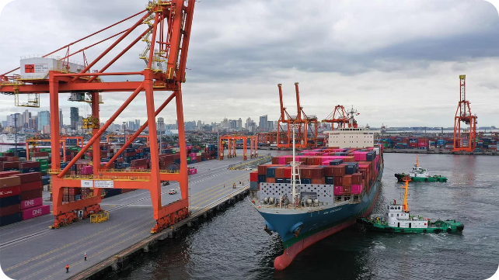

Container Terminal Simulation Case Study
This presentation explores a SimPy-based simulation designed to model and optimize the operations of a container terminal. We will delve into the key components, workflow, and insights gleaned from the simulation.
by Gaurav Anand

Slide 2

Introduction
Purpose
Methodology
Benefits
The simulation aims to replicate the complex interactions and logistics involved in a container terminal.
SimPy is employed to model and analyze the performance of the terminal under various scenarios.
The simulation provides valuable insights for optimizing operational efficiency and resource utilization.

Slide 3
Problem Description
1
Vessel Arrival
Vessels arrive at the terminal with a specific number of containers to be unloaded.
2
Berth Allocation
Vessels request berths and await availability, potentially leading to queuing.
3
Unloading Operations
Quay cranes handle container unloading, moving them to waiting trucks.
4
Yard Transportation
Trucks transport containers from the berth to the yard for storage or further handling.
5
Departure
The vessel departs once all containers have been unloaded and transported to the yard.

Slide 4
System Components
Berths
Quay Cranes
Trucks
Two berths are available to accommodate arriving vessels.
Two quay cranes are responsible for handling containers from vessels to trucks.
Three trucks are deployed for transporting containers to the yard.

Slide 5

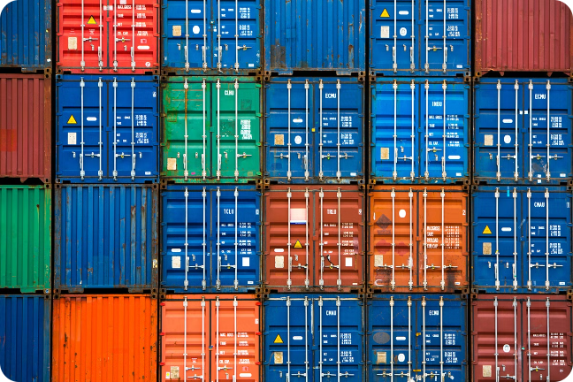
Simulation Parameters
Parameter
Description
Value
Vessel Arrival Rate
Average time between vessel arrivals
5 hours
Number of Containers
Average number of containers per vessel
150
Number of Trucks Trucks to load the 3 Trucks
container
Number of Cranes Cranes available to unload 2
Crane Handling Time
Time to unload a container
3 minutes
Truck Travel Time
Time to travel from berth to yard
6 minutes

Slide 6
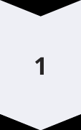
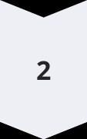
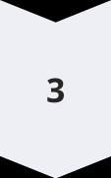
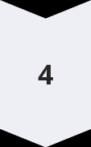

Simulation Workflow
Vessel Arrival
Vessels arrive at the terminal at random intervals, following a specified distribution.
Berth Allocation
Vessels request a berth, and are assigned one if available, otherwise they join the queue.
Container Unloading
Quay cranes are assigned to unload containers from the vessel and load them onto trucks.
Truck Transportation
Trucks transport containers from the berth to the yard, returning to the berth for further unloading.
Departure
Once all containers are unloaded, the vessel departs the terminal.

Slide 7

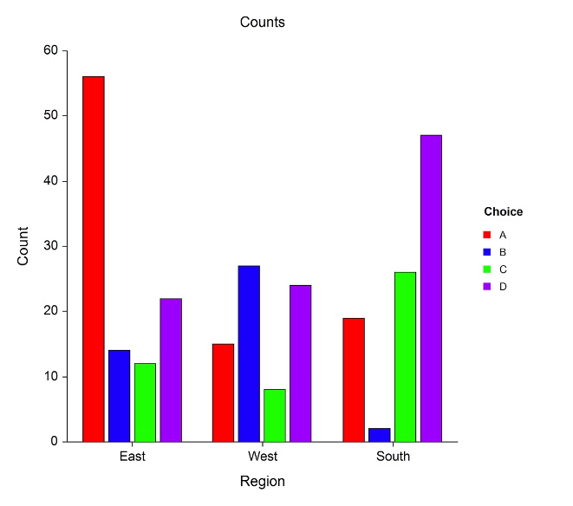
Simulation Results
1
Average Vessel Waiting Time
The simulation quantifies the average time vessels spend waiting for a berth, highlighting potential congestion issues.
2
Crane Utilization
The simulation analyzes the utilization rate of the quay cranes, identifying potential bottlenecks and scheduling challenges.
3
Truck Utilization
The simulation evaluates the efficiency of the truck fleet, optimizing transportation operations and minimizing idle time.
4
Container Handling Time
The simulation tracks the time taken to handle containers from arrival to transport, providing insights for improving overall efficiency.

Slide 8
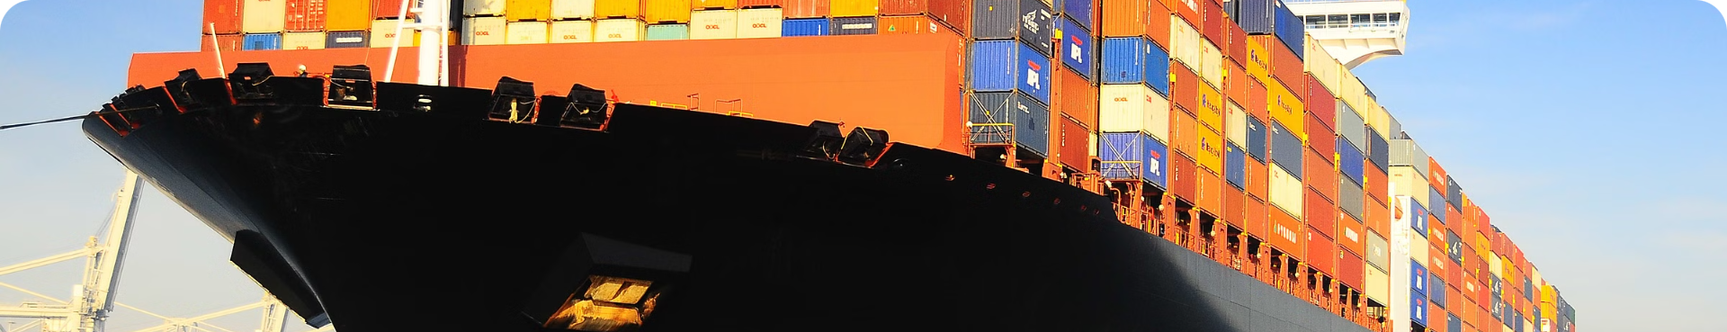



Conclusion
Enhanced Understanding
Data-Driven Optimization
Future Directions
The simulation provides a deep understanding of container terminal operations, highlighting potential areas for improvement.
The simulation offers valuable insights to support data-driven decision making for optimizing terminal efficiency.
Further research can explore different scenarios, such as incorporating real-time data and dynamic adjustments.

